Slide 1
Android for Beginers
Building Layouts

Slide 2
Contents
Vocab Words
XML Syntax
Density Independent Pixel
Text Size
Text Color

Slide 3
Vocab Words
Throughout the course you’ll be exposed a lot of new Android vocabulary.
Layout
User Interface
TextView
ImageView
Button
Camel case
So to help you get aquainted we've built this Android for All Vocabulary Glossary, which you can reference anytime you need to look up a word's definition.
The more you use it, you'll reinforce your learning and even start committing some terms to memory!

Slide 4
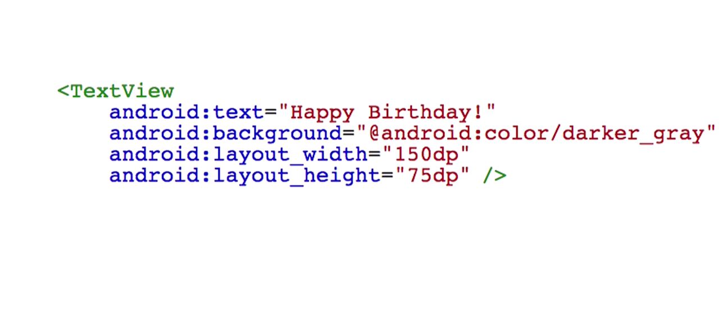
XML Syntax
an opening angle bracket
the view name
the attributes
the forward And then the closing angle bracket

Slide 5
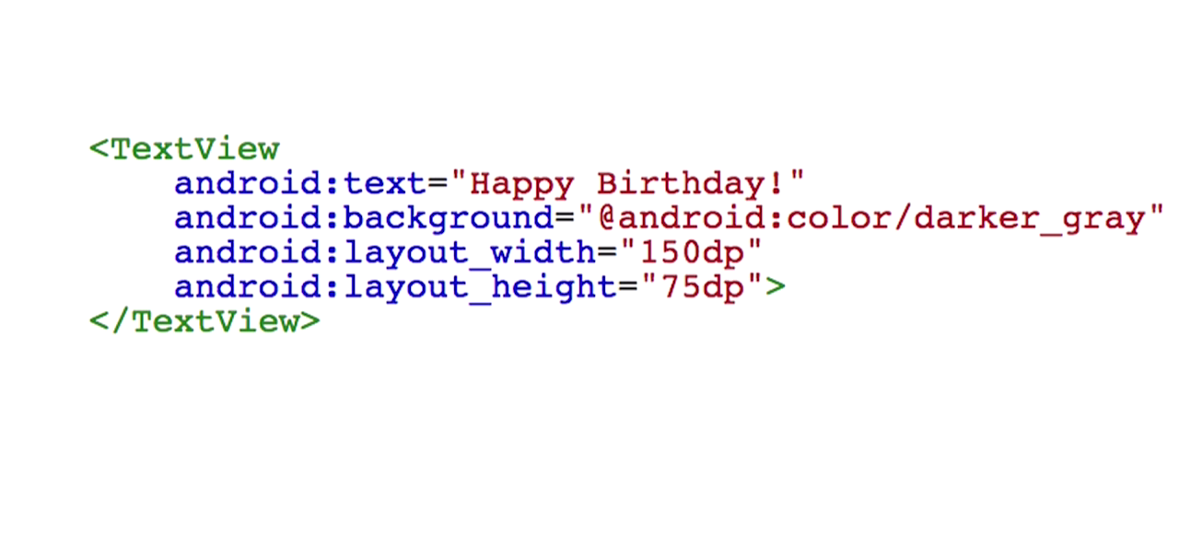
XML Syntax
Instead of a self-closing tag, you could have a separate opening tag and a separate closing tag

Slide 6
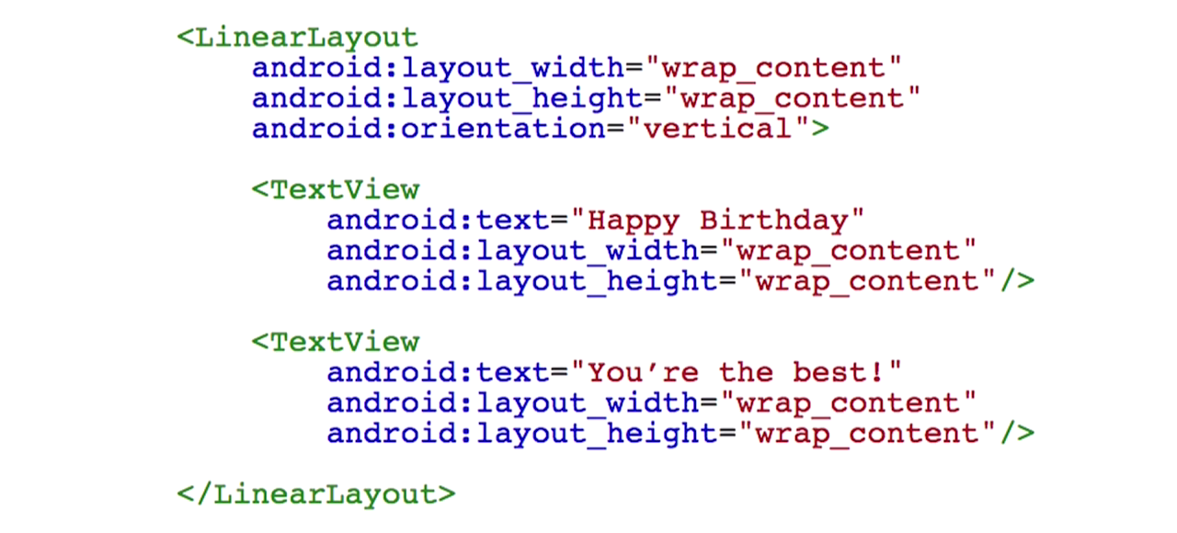
XML Syntax
These are also called children XML elements within the parent LinearLayout.

Slide 7
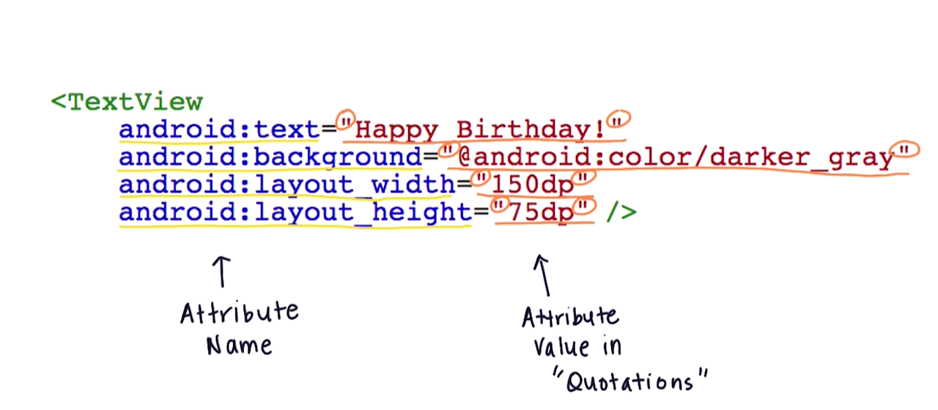
XML Syntax
Attributes are characteristics that determine the behavior or the appearance of the view.

Slide 8
XML Visualizer
Link to the XML Visualizer
48dp translates to approximately 9mm in physical size. See more info here.
What does Density Independent Pixel actually mean? You can look up its definition in the Vocab Gloassary.

Slide 9
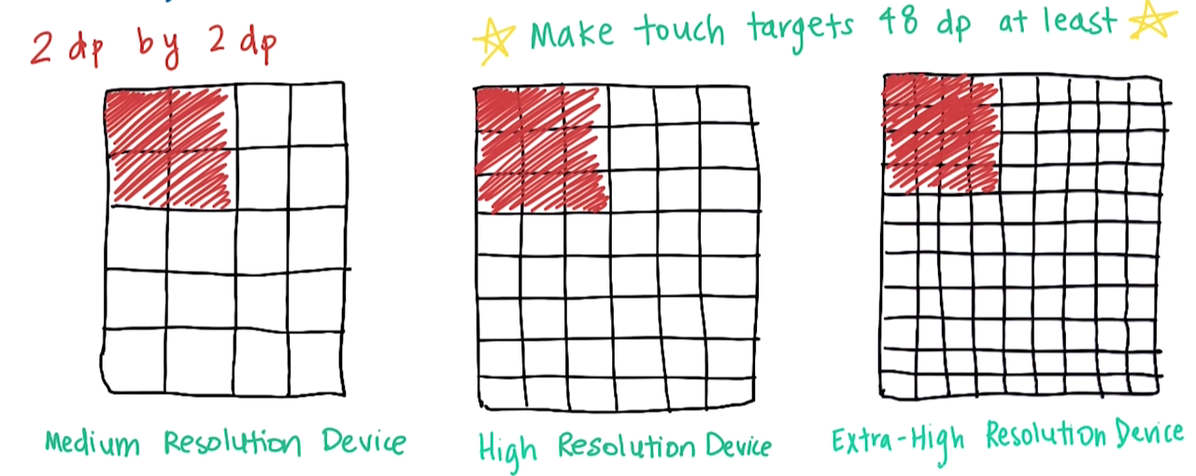
Density Independent Pixel
48dp translates to approximately 9mm in physical size.

Slide 10
TextView Text Size
Material Design typography guidelines
The basic set of styles are based on a typographic scale of 12, 14, 16, 20, and 34.
Across form factors, text that appears in the app bar should use the Title style, Medium 20sp.
Button style (Medium 14sp, all caps) is used for all buttons.

Slide 11
TextView Text Color
Material Design color palette
More info on Hex colors
Click here and search for: Hex Color

